Slide 1
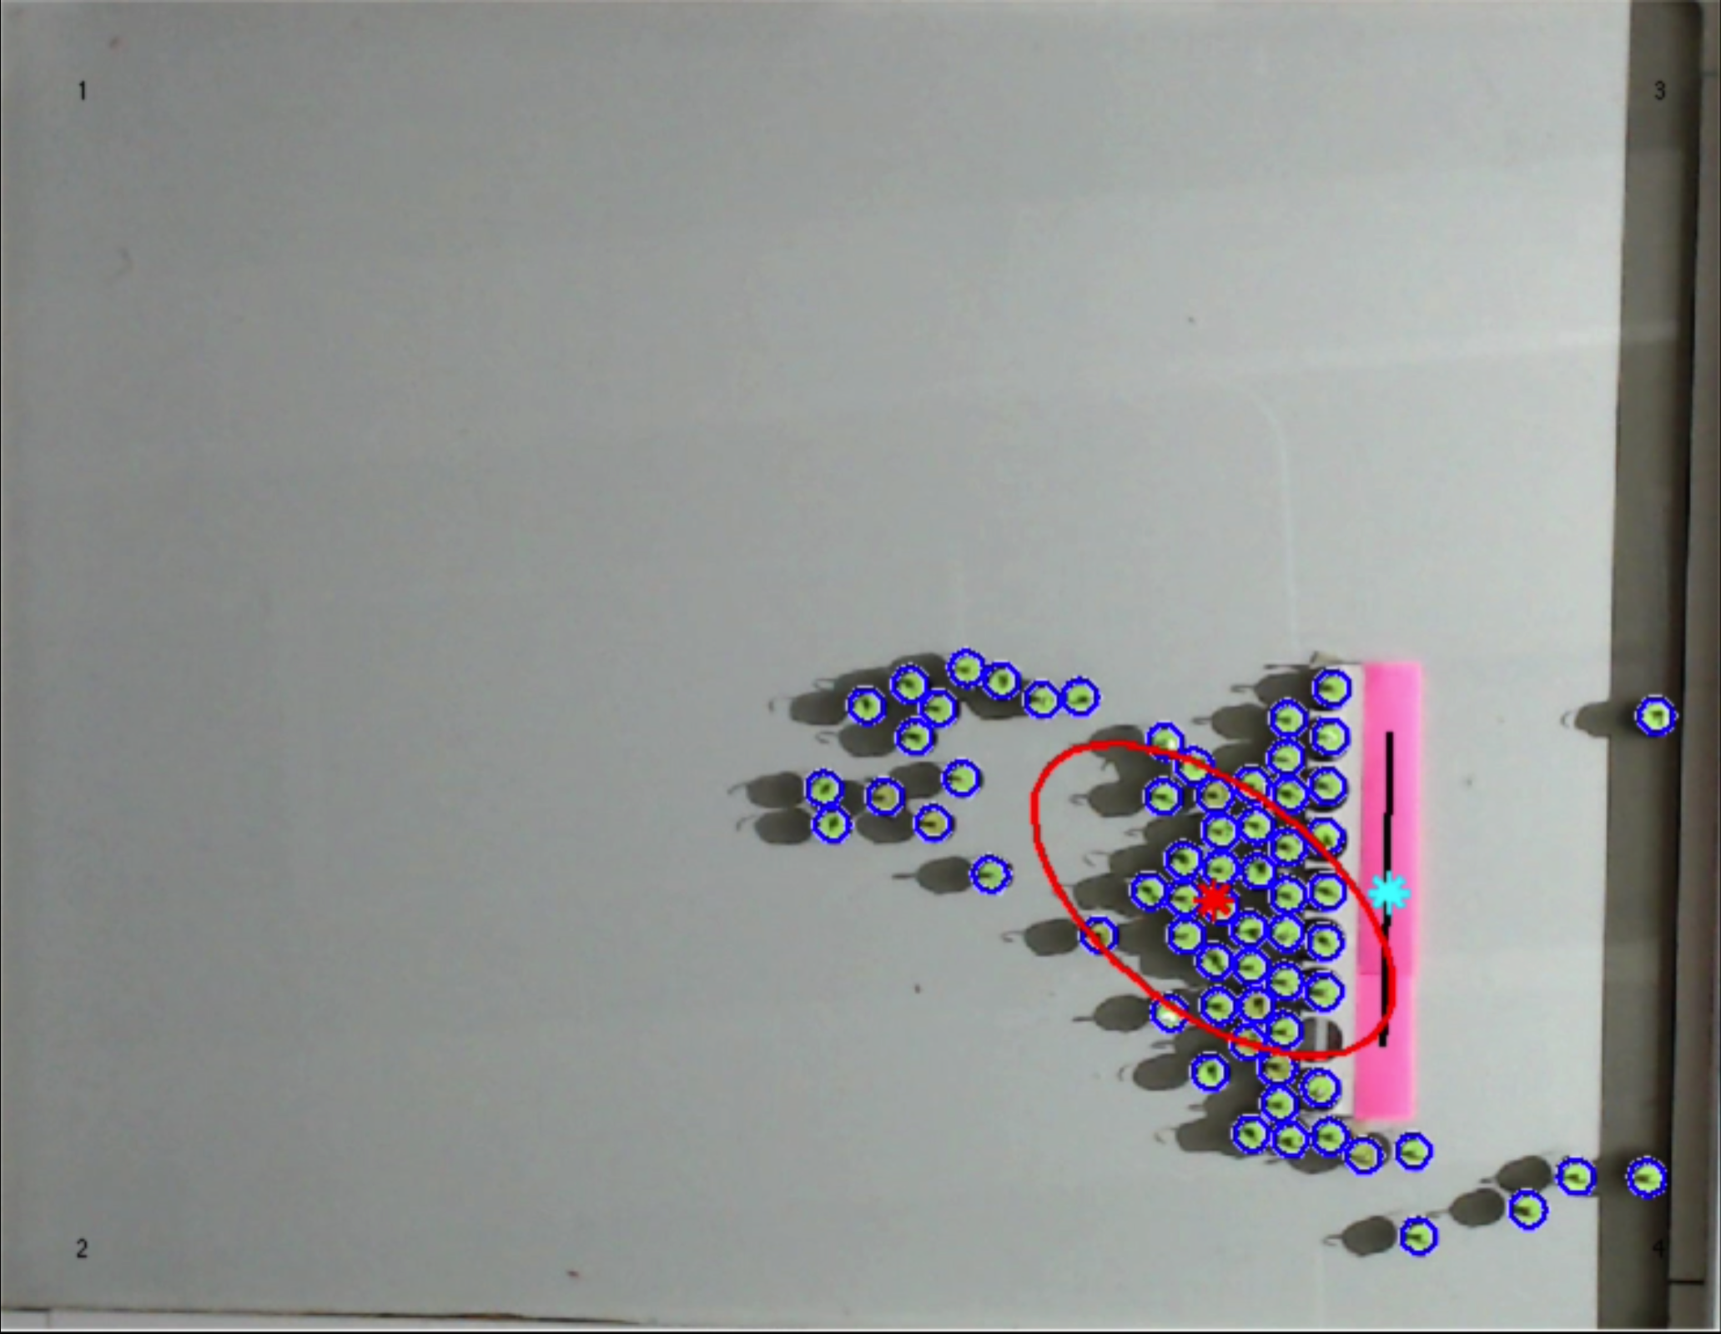
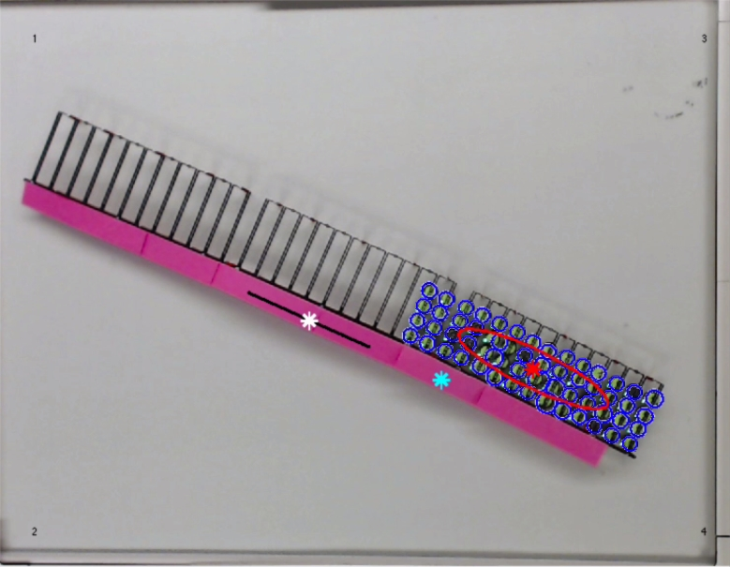
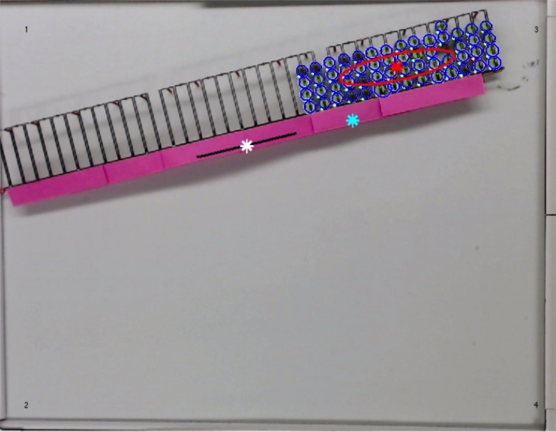
α ~ 43°
−θ
a)
b)
Robots
c)
θ
Mean of Swarm
Robot Direction
Confidence Ellipse
Pivot Point

